Slide 1

PROVINCIAL OWN REVENUE
TREASURY GUIDELINE WORKSHOP
07 JUNE 2018

Slide 2

Structure of Presentation
Macroeconomic challenges
Comparative analysis
Own-revenue trends
Provincial challenges
Reminders
Conclusion

Slide 3

Macroeconomic Challenges
Nationally
  High debt servicing costs
  Lower employment potential
  Economy downgrade
  Exchange rate uncertainty
  High inflation rate
  Relatively higher interest rate

Slide 4
Comparative Analysis
REVENUE RANKING PER PROVINCE
Audited Outcome |  |  |  | Preliminary |  | Medium-term Estimate
Province | 2014/15 | 2015/16 | 2016/17 | Province | 2017/18 | 2018/19 | Province | 2019/20 | Province | 2020/21
GP | 4 964 753 | 5 421 231 | 5 844 189 | GP | 6 087 032 | 6 014 366 | GP | 6 367 449 | GP | 6 733 892
KZN | 3 260 603 | 3 031 768 | 3 125 276 | KZN | 3 322 246 | 3 236 438 | KZN | 3 349 606 | KZN | 3 473 612
WC | 2 907 833 | 2 862 388 | 2 625 762 | WC | 3 110 766 | 3 022 966 | WC | 2 930 789 | WC | 3 007 636
EC | 1 451 441 | 1 374 405 | 1 882 714 | EC | 1 713 346 | 1 414 636 | EC | 1 497 982 | EC | 1 580 371
NW | 1 413 763 | 1 213 131 | 1 457 539 | MP | 1 328 475 | 1 320 099 | LIM | 1 382 199 | LIM | 1 485 997
FS | 892 144 | 998 895 | 1 024 990 | LIM | 1 308 253 | 1 247 168 | MP | 1 342 695 | NW | 1 374 221
LIM | 888 992 | 953 289 | 1 022 254 | NW | 1 228 797 | 1 209 862 | NW | 1 276 225 | MP | 1 369 382
MP | 862 494 | 832 699 | 897 485 | FS | 1 062 377 | 1 090 642 | FS | 1 146 809 | FS | 1 208 247
NC | 296 985 | 328 973 | 337 637 | NC | 351 801 | 360 574 | NC | 382 007 | NC | 403 015
Total Revenue | 16 939 008 | 17 016 779 | 18 217 846 |  | 19 513 093 | 18 916 751 |  | 19 675 761 |  | 20 636 373

Slide 5
Comparative Analysis

Slide 6
Own Revenue Trends

Slide 7
Preliminary Revenue
2017/18
The preliminary revenue collected R3.322 billion exceeding the budget of R3.038 billion. Major contributors to the over-collection were:
  Interest Revenue
  Patients fees
  Tax receipts
    Motor vehicle licence fees
    Casino taxes

Slide 8

Own Revenue Trend

Slide 9
Own Receipts by Vote

Slide 10
Economic Classification

Slide 11
Main Revenue Sources

Slide 12

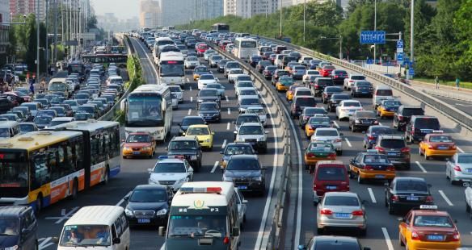
Provincial Challenges
  Migration of motor vehicles (esp. companies) to cheaper provinces
  KZN’s tariffs are kept constant in order to reduce leakages to other provinces

Slide 13


Provincial Challenges
  Delayed implementation of new billing system
  System challenges for the lodging of claims through Compensation Occupational Injuries and Diseases Act (COIDA) resulted in under-collection on that item

Slide 14

Tariff Approval
To formulate the budget for the outer year (2021/22) must be based on scientific methodology or add CPI plus one on the budget for 2020/21
All the departments must submit proposed tariff review annually
The approved tariffs must be incorporated into the projections accordingly
Closing date for Tariff reviews is November each year

Slide 15
Monthly Revenue Reporting
Departments are required to submit a Detailed Revenue Variance Report monthly together with the RIYM
Electronic reports are due on the 15th of each month
Signed copies are due by the end of each month

Slide 16
Conclusion
Working together we can do more

